Slide 1
DATA ANALYSIS ON WEATHER FORECASTING
Prepared by,
Trupti Shingala

Slide 2
Introduction: Dataset
We have used weather forecast dataset having 366 observations from rattle package in R.
Used following Independent variables from the dataset:
Max_Temperature , Min_Temperature, WindSpeed3pm, WindSpeed9am, Pressure3pm, Humidity9am, Humidity3pm,RainToday, RainTomorrow.

Slide 3
Data Clean and Goals
Replaced the missing value with the field mean for numerical data.
Implement various algorithms on the data to help derive conclusion on classification and clustering of data.

Slide 4
Algorithms used
Classification:
K-nearest neighbors
Naive Bayes
Decision Tree- Rpart
Clustering:
K means clustering

Slide 5
Classification and Regression Tree
The decision trees produced by CART are strictly binary, containing exactly two branches for each decision node.
CART recursively partitions the records in the training data set into subsets of records with similar values for the target attribute.
The CART algorithm grows the tree by conducting for each decision node, an exhaustive search of all available variables and all possible splitting values.
Formula = Rain_Tomorrow ~ min_temp+ max_temp+windspeed9am+windspeed3pm+humidity3pm+pressure3pm

Slide 6
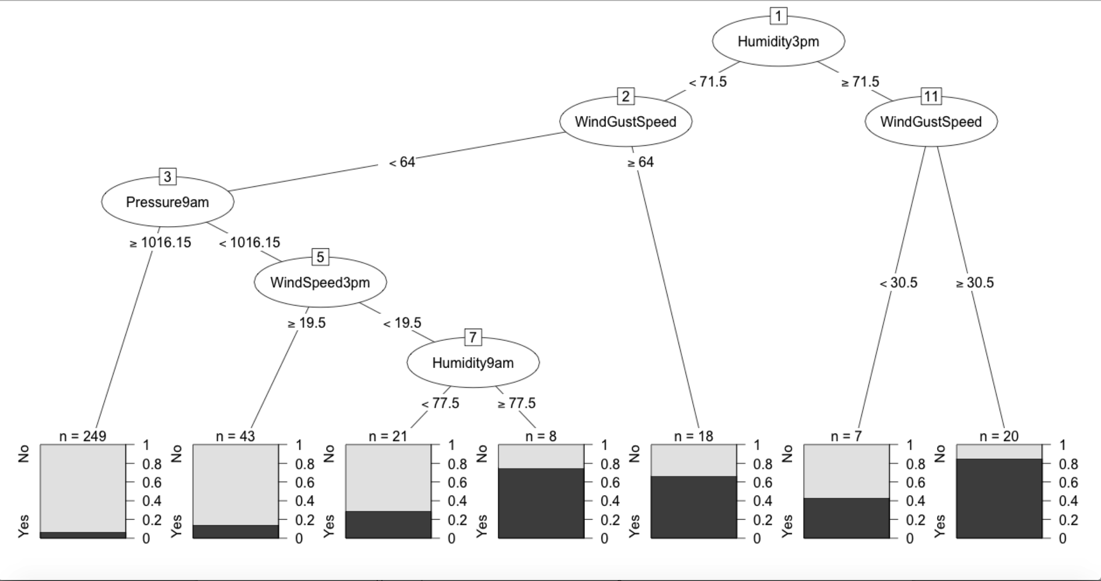
Decision Tree

Slide 7
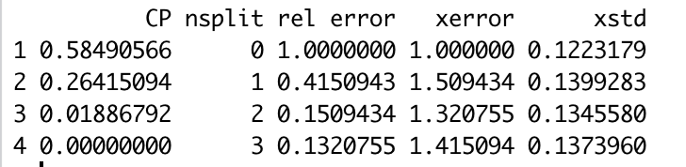
Decision Tree
To determine if the tree is appropriate or if some of the branches need to be subjected to pruning we can use the cptable element of the rpart object:
The xerror column contains of estimates of cross-validated prediction error for different numbers of splits (nsplit). The best tree has three splits.
Now we can prune back the large initial tree using the min Cp value.

Slide 8
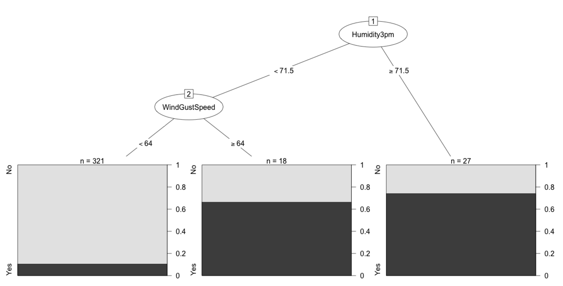
The error rate of the decision tree after pruning is 16%

Slide 9

K-MEANS CLUSTRING
k-means clustering is a method of vector quantization, originally from signal processing, that is popular for cluster analysis in data mining.
The goal of K-Means algorithm is to find the best division of n entities in k groups, so that the total distance between the group's members and its corresponding centroid, representative of the group, is minimized.
Formally, the goal is to partition the n entities into k sets S_{i}, i=1, 2, ..., k in order to minimize the within-cluster sum of squares (WCSS), defined as:

Slide 10
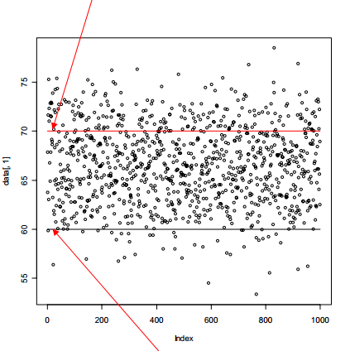
K-means Algorithm Step #1
A typical version of the K-means algorithm runs in the following steps:
1. Initial cluster seeds are
chosen (at random).
– These represent the
“temporary” means of the
clusters.
– Imagine our random
numbers were 60 for
group 1 and 70 for group
SEED1
SEED2

Slide 11
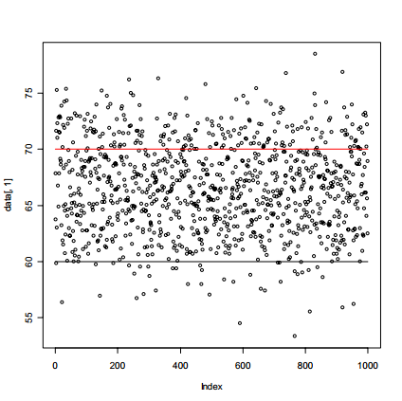
K-means Algorithm Step #2
2. The squared
Euclidean distance
from each object to
each cluster is
computed, and each
object is assigned to
the closest cluster.

Slide 12
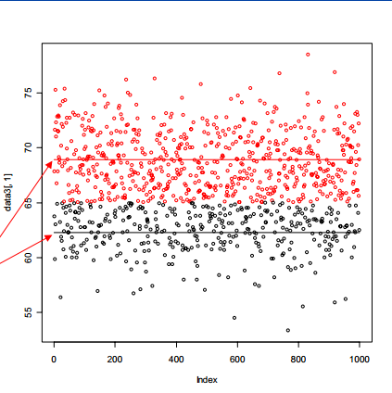
K-means Algorithm Step #3
3. For each cluster, the new centroid is computed – and each seed value is now replaced by the respective cluster centroid.
• The new mean for cluster 1 is 62.3
• The new mean for cluster 2 is 68.9

Slide 13
K-means Algorithm Step #4 – #6
4. The squared Euclidean distance from an object to each cluster is computed, and the object is assigned to the cluster with the smallest squared Euclidean distance.
5. The cluster centroids are recalculated based on the new membership assignment.
6. Steps 4 and 5 are repeated until no object moves clusters.

Slide 14
Applications
market segmentation
computer vision
geostatistics
astronomy
Agriculture
It often is used as a preprocessing step for other algorithms, for example to find a starting configuration.

Slide 15


FREQUENCY TABLE
for k=2

Slide 16
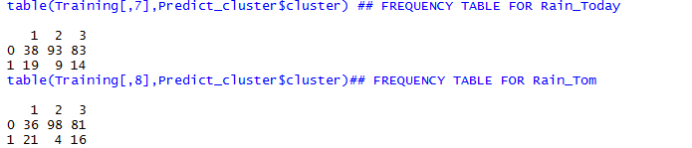
For k=3

Slide 17
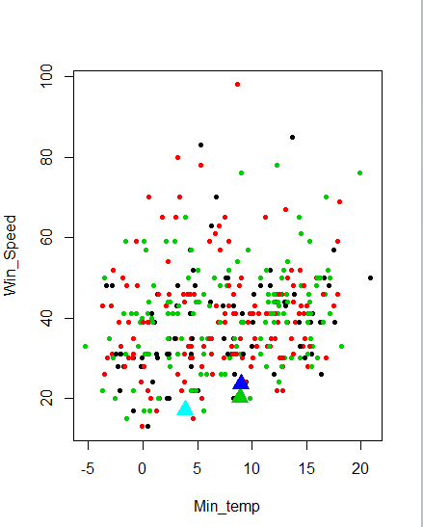
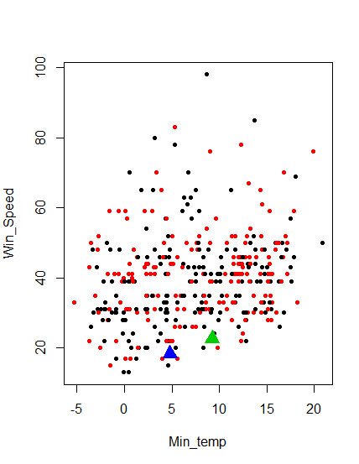
PLOTTING CLUSTER
FOR K=2
FOR K=3

Slide 18
Naïve Bayes Classifier
Computes the conditional a-posterior probabilities of a categorical class variable given independent predictor variables using the Bayes rule.

Slide 19
Naïve Bayes Classifier(Cont..)
Naive Bayes classifiers assume that the effect of a variable value on a given class is independent of the values of other variable. This assumption is called class conditional independence.
An advantage of the naive Bayes classifier is that it requires a small amount of training data to estimate the variable values necessary for classification.

Slide 20
Naïve Bayes Classifier(Cont..)
Here, we implemented Naïve Bayes on RainToday and RainTomorrow attributes with another attributes of MinTemp, MaxTemp, Temp9am, Temp3pm, Pressure9am, Pressure3pm.

Slide 21
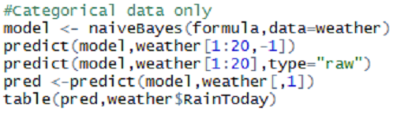
Naïve Bayes Classifier(Cont..)
Perform naïve Bayes on categorical data only. Here in predict model if type is row then the conditional a-posterior probabilities for each class are returned.
Else the class with maximum probability is returned

Slide 22
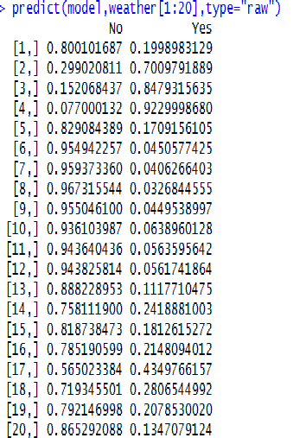
Naïve Bayes Classifier(Cont..)
Output
Pred | No | Yes
No | 300 | 66
Yes | 0 | 0

Slide 23
Naïve Bayes Classifier(Cont..)
Perform naïve Bayes using Laplace smoothing. It is technique that used to smooth categorical data.
The default (0) value of laplace disables Laplace smoothing.

Slide 24
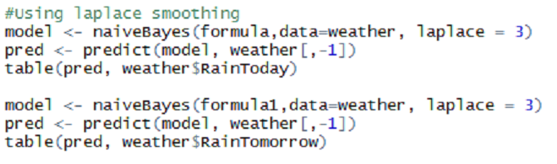
Naïve Bayes Classifier(Cont..)
RainToday
RainTomorrow
Pred | No | Yes
No | 271 | 38
Yes | 29 | 28
Pred | No | Yes
No | 258 | 34
Yes | 42 | 32

Slide 25
K - Nearest Neighbor
It is a Lazy Learning Algorithm
Whenever we have a new point to classify , we find its K nearest neighbors from the training data
It Defers the decision to generalize the past training examples till a new query is encountered
K-NN uses distance function to calculate the distance between points from the center
Our Goal is to specify for which value of K the weather data is most accurate

Slide 26
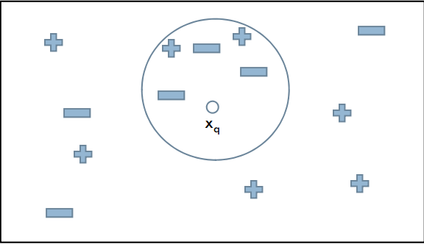
K - Nearest Neighbor
Given a query instance xq to be classified,
Let x1,x2….xk denote the k instances from
training examples that are nearest to xq
Return the class that represents the maximum of the k instances
For eg: if we take K=5
In this case query Xq
Will be classified as
Negative since 3 of its
Nearest neighbors are classified as negative

Slide 27


K-Nearest Neighbor – Transitional Conclusions
For K = 1 we have following Table result & error rate for rain tomorrow
For K = 2 we have following Table result & error rate for rain tomorrow

Slide 28


K - Nearest Neighbor
For K = 5 we have following Table result & error rate for rain tomorrow
For K = 10 we have following Table result & error rate for rain tomorrow

Slide 29
K-Nearest Neighbor – Conclusions and Error Rate
The error rate changes every time since the training and the test dataset are not stable
The error rate is 21%

Slide 30
Comparison of Algorithms
Accuracy of the following algorithms are:
KNN – 79%
K-means – 80.5%
Decision tree – 84%

